Slide 1

LEVERAGING AZURE VMSS FOR HIGH AVAILABILITY IN WEB APPLICATIONS
Presented By :
K.Ganesh
R.Arvind Reddy
Abdul Muqeeth
Arjun Rongala
VITS | 2024

Slide 2
1
INTRODUCTION
In today's digital era, ensuring high availability and scalability of web applications is crucial to meet user demands and provide uninterrupted services. Azure Virtual Machine Scale Sets (VMSS) offer a robust solution by enabling the automatic scaling and management of virtual machines to handle varying workloads efficiently. By leveraging Azure VMSS, organizations can achieve fault tolerance, minimize downtime, and ensure that their applications remain responsive, even during traffic spikes or unexpected failures.
VITS | 2024

Slide 3

3
INTRODUCTION
This technology provides the flexibility to scale out during peak usage and scale in during low activity, optimizing resource utilization and cost
VITS | 2024

Slide 4
4
OVERVIEW
PROJECT GOAL
Build a highly available and scalable web application utilizing Azure VMSS.
HIGH AVAILABILITY
Ensure high availability through automatic scaling to meet user demands.
Traffic Distribution
Implement a load balancer to efficiently distribute incoming traffic.
Latency Reduction
Reduce latency by deploying multiple instances of the application.
VITS| 2024

Slide 5
5
IMPLEMENTATION
1. website creation.
2. githb upload (https://github.com/dhruva2113/grandcoffee.git)
3. create VM with custom script
4. after deployment - check vm if our website is working or not
5. Capture > image > delete vm check box on> "imagegallery" > "imagedef" > version 1.0.0 > create
6. create vmss from the output
7. check if the image is our image or something else.
8. Set autoscaling (1,2,1) 25% increase 10% decrease , create loadbalancer in networking tab
9. create VMSS
10. after creation > go to instances > select the vm > copy and paste your ip address in new tab to check your website is live
11. go back in the vm > set inbound rule (*) in network settings > connect to vm in powershell > run stress test ( stress --cpu 1 --vm 1 --io 1 --hdd 1 --timeout 5m )
12. come back to portal in vmss > metrics > percentage cpu graph, set time to last 30min and 1 min update > look if the stress is working and check/refresh the instances in other tab > once the cpu stress is beyond our given rule, the instance would increase to 1.
13. show that we can access the website via 2 instances ip address and is highly available.
VITS | 2024

Slide 6
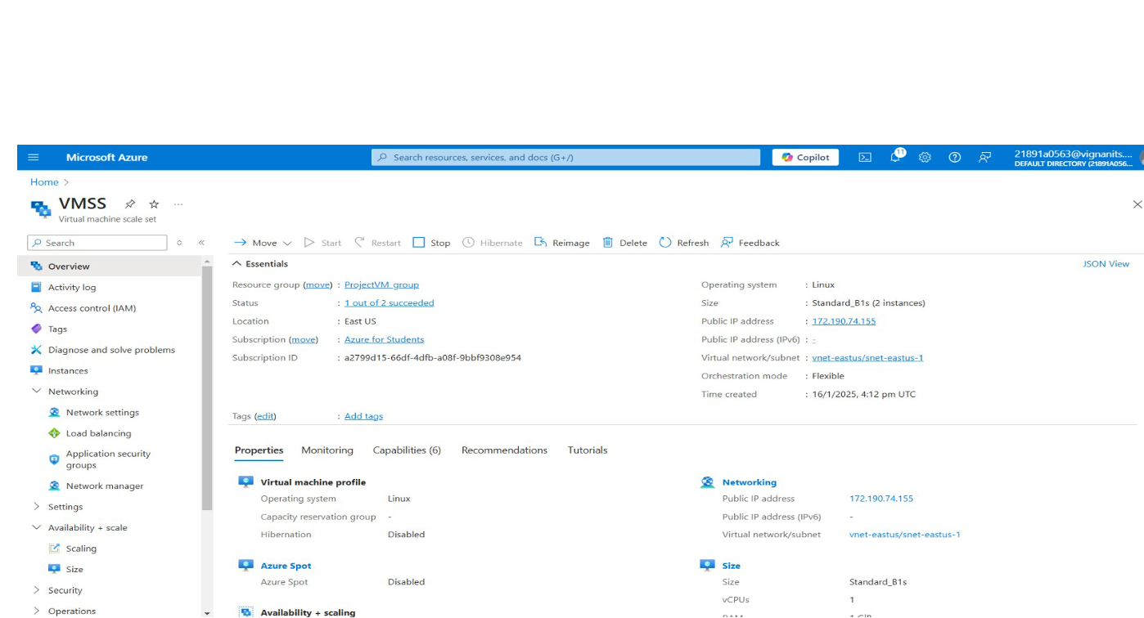
VMSS
6
VITS | 2024

Slide 7
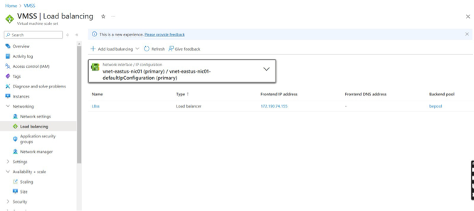
VMSS LOAD BALANCING
7
VITS| 2024

Slide 8
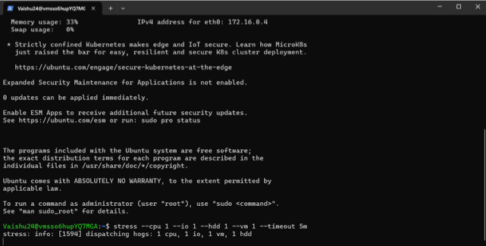
VMSS POWERSHELL
8
VITS | 2024

Slide 9
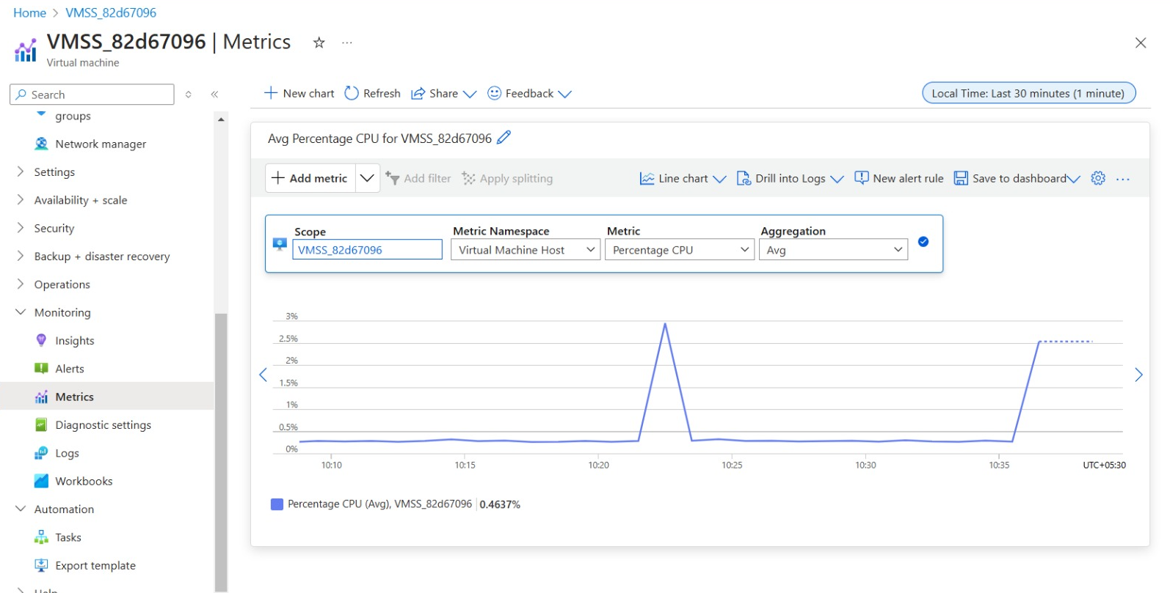
VMSS METRICS
9
VITS| 2024

Slide 10
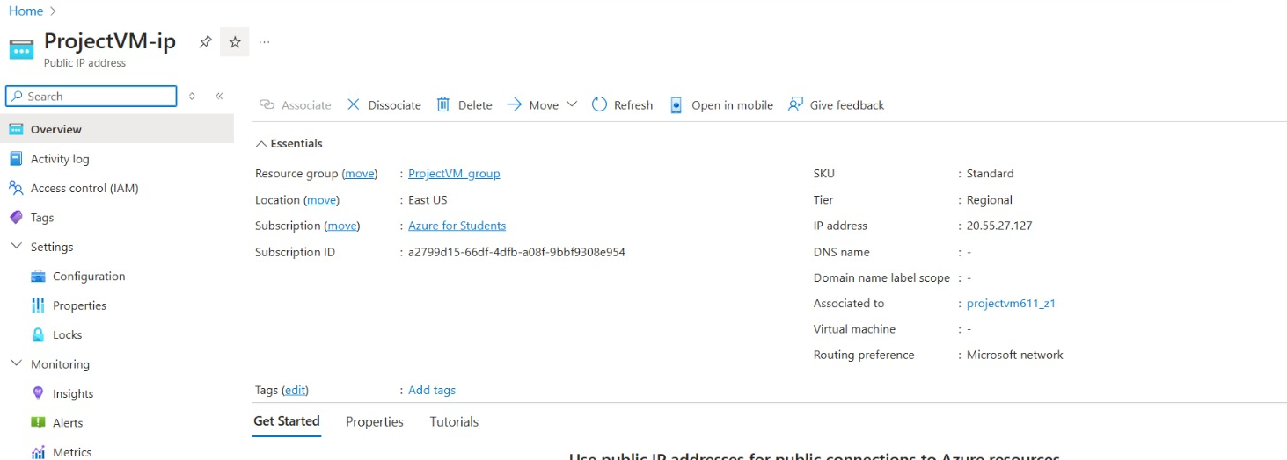
VMSS METRICS
10
VITS| 2024

Slide 11
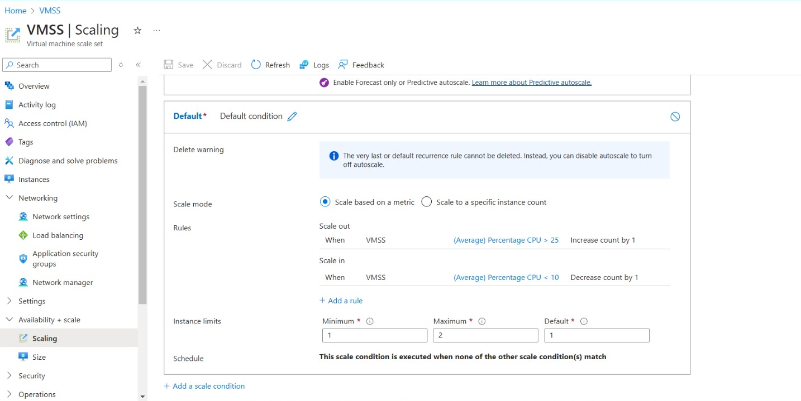
VMSS SCALING
11
VITS| 2024

Slide 12
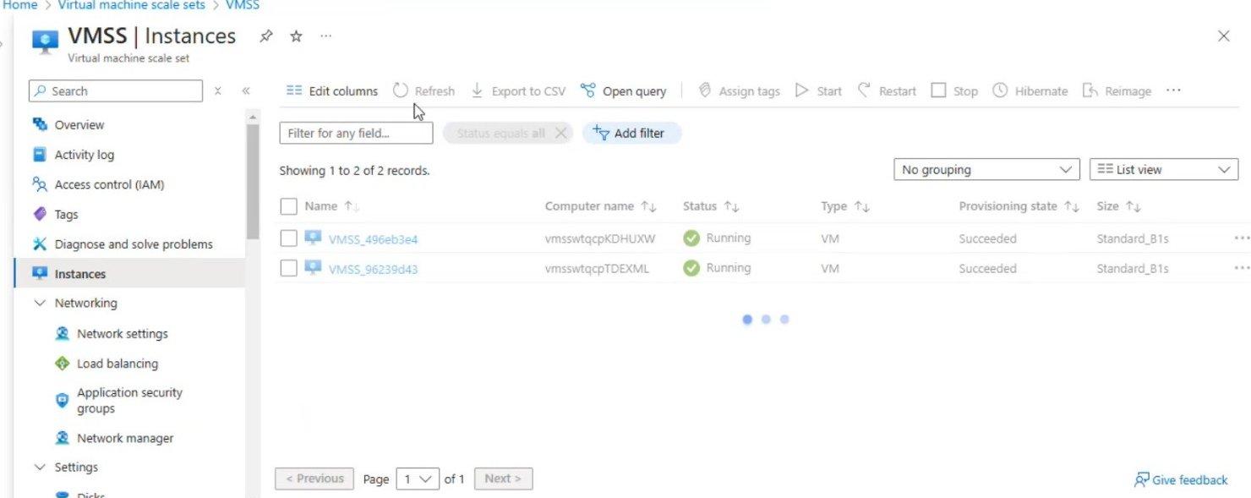
VMSS INSTANCES
12
VITS| 2024

Slide 13
13
BENEFITS
High Availability
Scalability
Cost Efficiency
Fault Tolerance
Load Balancing
Simplified Management
Reusability
Monitoring and
Resilience Under Stress
Global Reach
VITS | 2024

Slide 14

14
CONCLUSION
Azure Virtual Machine Scale Sets (VMSS) provide a powerful solution for building highly available and scalable websites. With features like autoscaling, load balancing, and reusable VM images, it ensures reliability, fault tolerance, and cost efficiency. By automating scaling and optimizing resource usage, VMSS simplifies management while delivering seamless performance, making it an ideal choice for modern web applications.
VITS | 2024

Slide 15
THANK YOU

